Slide 1




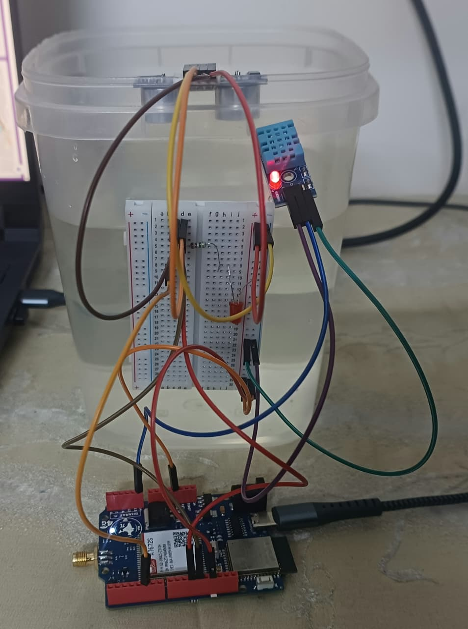
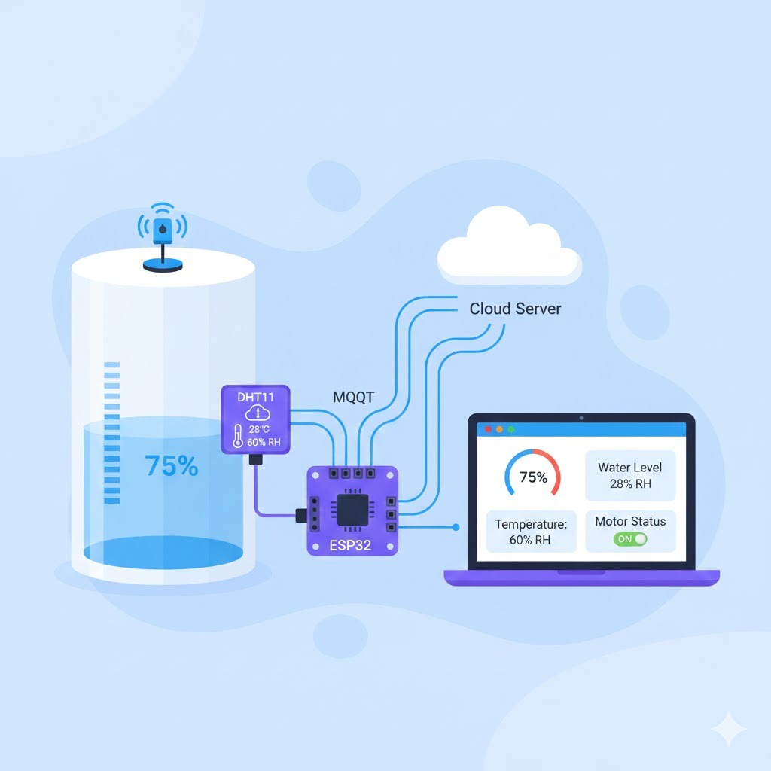
Samsung Innovation Campus (IoT) Indian Institute of Information Technology Design and Manufacturing, Kurnool
Tank Monitoring and Operational Control
Team Members
Shyam Prasad – 122EC0006
S. Sumanth – 122EC0010
M.Sai Uttam – 122EC0020
Sumanth Siddamdhetty – 122EC0033

Slide 2
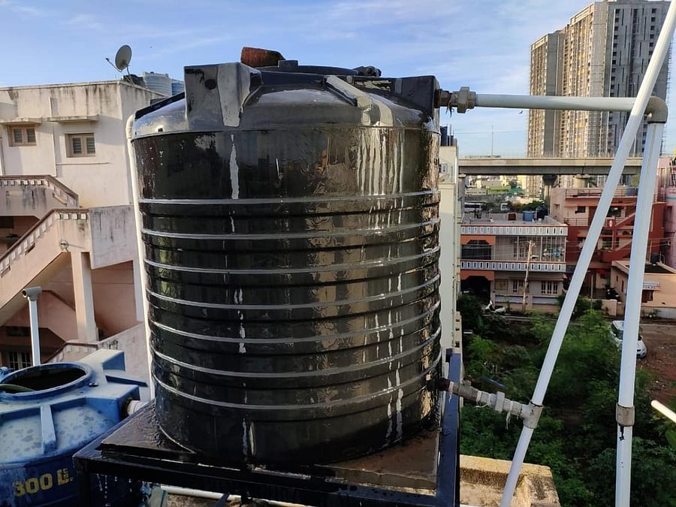



Challenges in Conventional Water Tank Management
Manual monitoring leads to human errors and inefficiency
Water overflow causes wastage and poor resource utilization
No real-time alerts or remote monitoring
High electricity consumption due to improper motor usage
Dry running of motors damages pumps and increases maintenance cost
➡️ Need: An automated, smart, real-time monitoring system

Slide 3
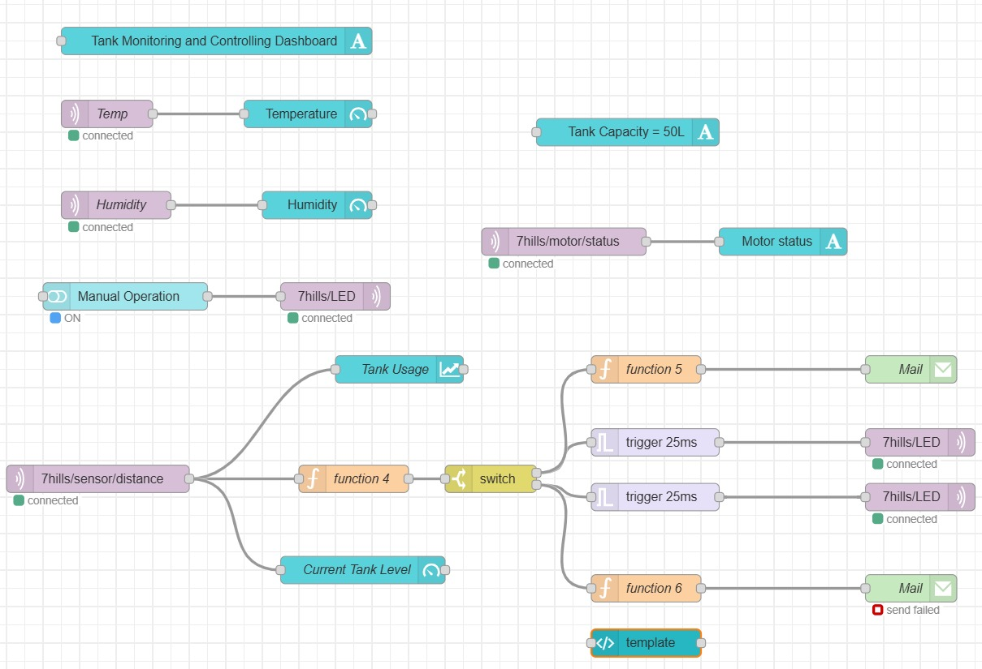
Proposed Smart IoT-Based Solution
Continuous water level monitoring
The system continuously measures the water level in the tank using an ultrasonic sensor mounted at the top. The sensor calculates the distance to the water surface in real time, allowing accurate and uninterrupted monitoring without manual intervention.
Real-Time Dashboard Visualization
All sensor data, including water level, temperature, humidity, and motor status, is displayed live on a Node-RED dashboard. This enables users to instantly view the tank condition from any internet-connected device, ensuring transparency and ease of monitoring.
Remote Motor Control Using LED Simulation
Motor operation is simulated using an LED, where the LED ON state represents the motor running and LED OFF represents the motor stopped. Through the dashboard, users can remotely control this LED, demonstrating how real motor control can be implemented using a relay in actual deployment.
Interface of the created IOT dashboard

Slide 4

Proposed Smart IoT-Based Solution contd….
Automatic Email Alerts at Critical Levels
The system automatically sends email notifications when the water level crosses predefined thresholds—below 10% (low level) and above 90% (high level). These alerts help prevent dry running of the motor and water overflow without requiring continuous supervision.
Reduction in Water Wastage, Power Loss, and Manual Effort
By automating monitoring, alerting, and control, the system significantly reduces water wastage caused by overflow and minimizes electricity loss due to unnecessary motor operation. It also eliminates the need for frequent manual checks, making water management more efficient and reliable.

Slide 5
System Architecture
Three-Layer IoT Architecture:
1. Sensing Layer
2. Network Layer
3. Application Layer
Ultrasonic Sensor (HC-SR04)
DHT11 (Temperature & Humidity)
LED for motor status indication
Wi-Fi communication
MQTT protocol via EMQX broker
Node-RED dashboard
Email alert system

Slide 6
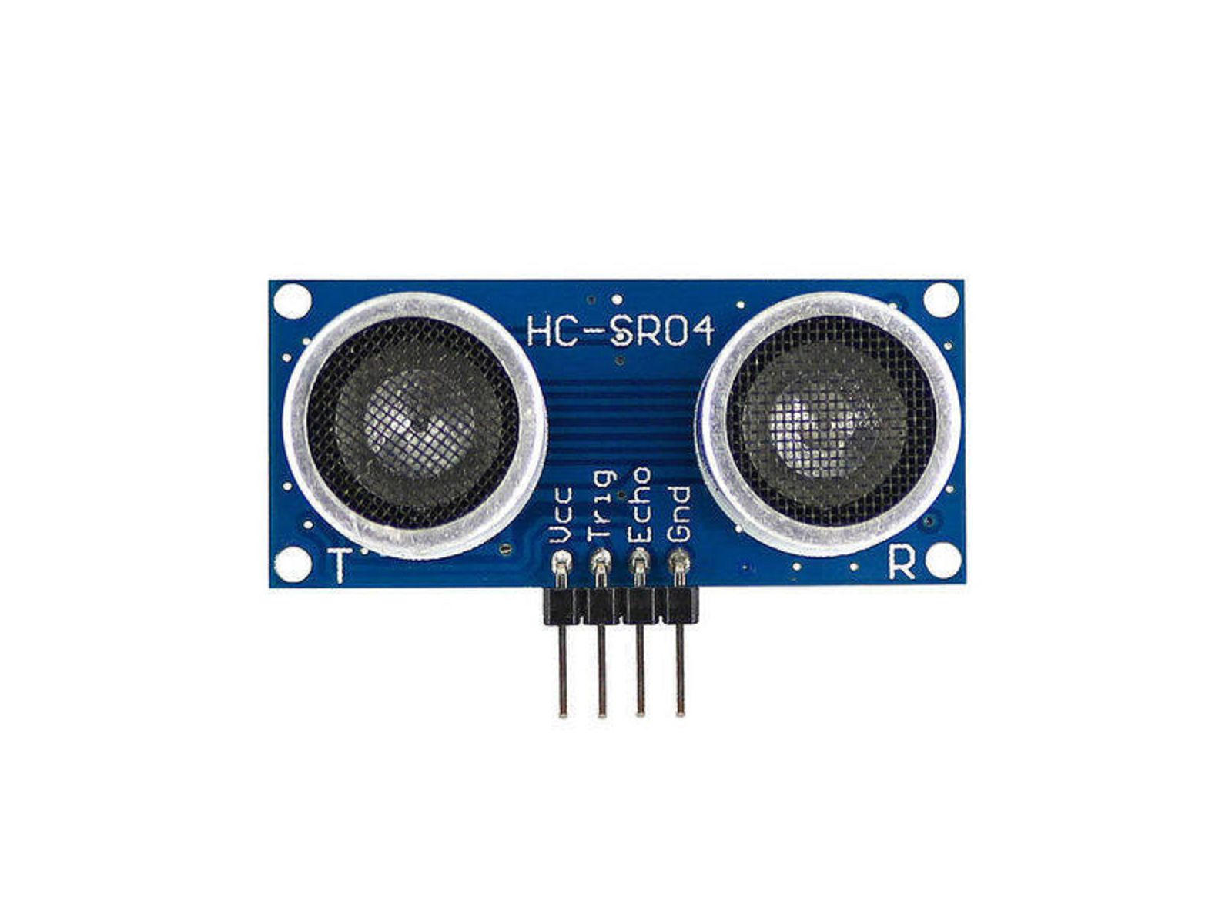

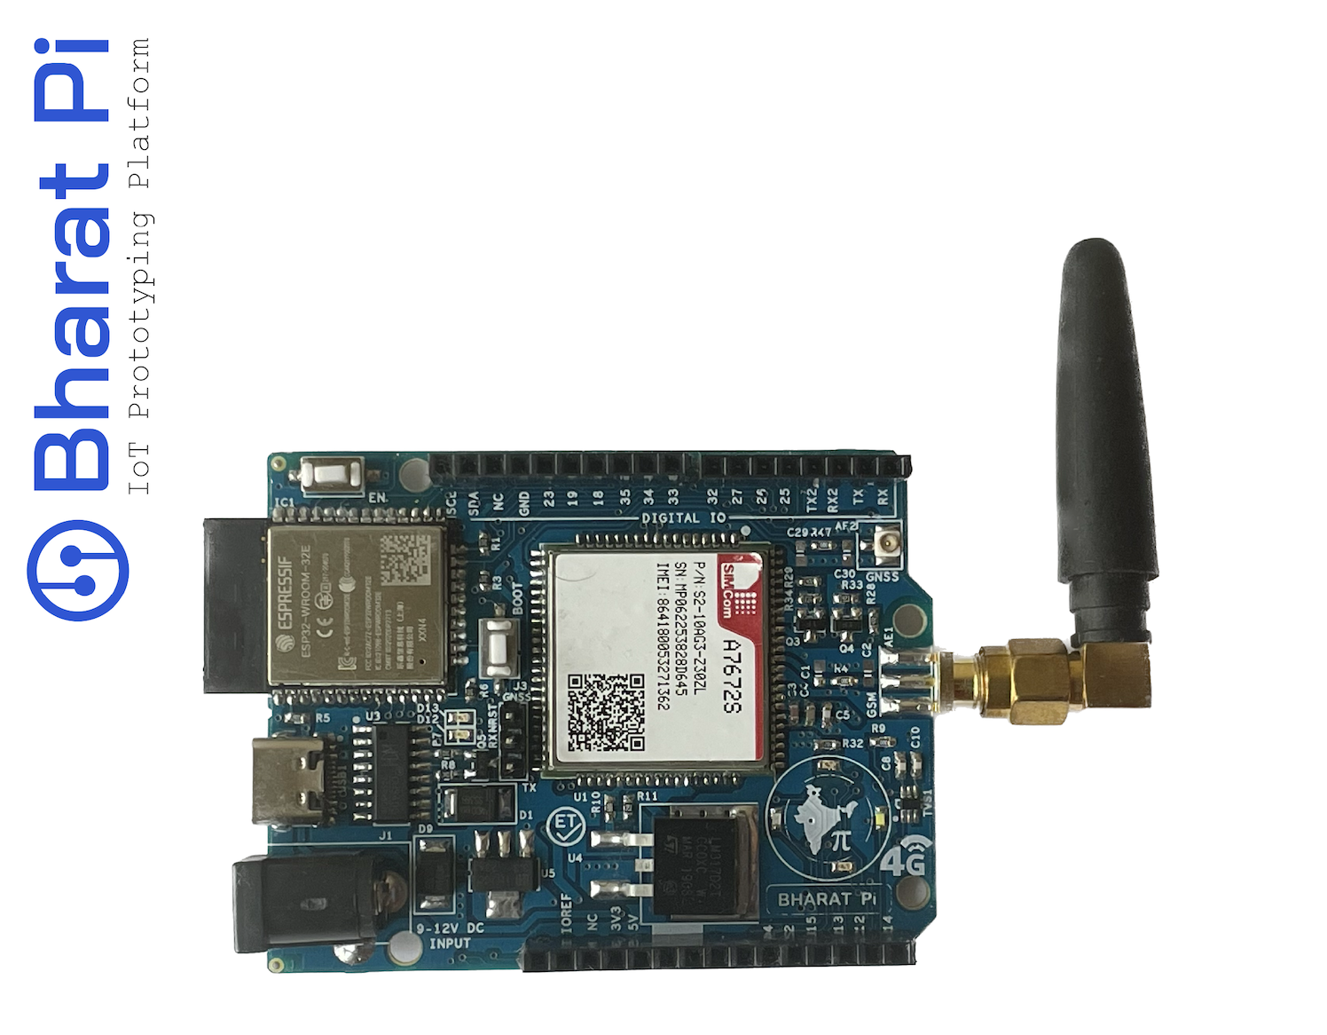
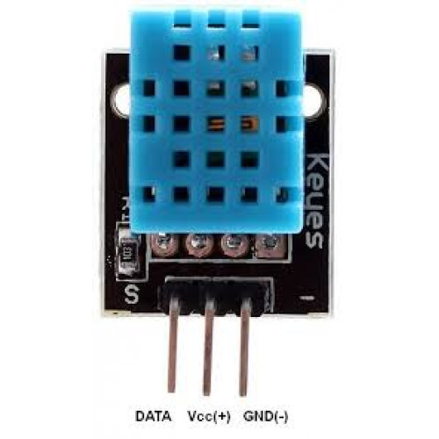
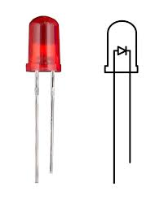
Core Hardware Components
ESP32 Microcontroller
HC-SR04 Ultrasonic Sensor
Central controller for sensors & Wi-Fi
Measures water level accurately
DHT11 Sensor
LED (Motor Simulation)
Hardware Setup
Represents motor ON/OFF state
Measures temperature and humidity

Slide 7
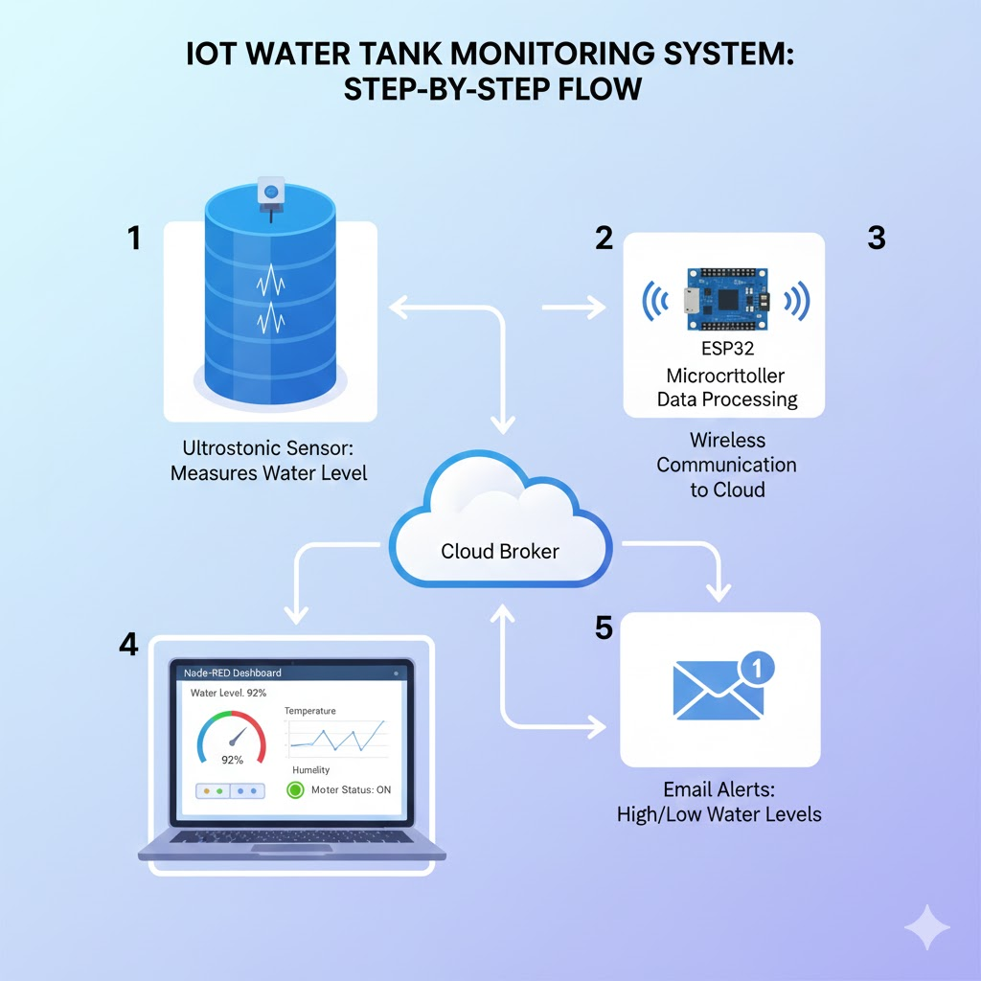
System Operation Flow
Working Principle
ESP32 connects to Wi-Fi
MQTT broker connection established
Ultrasonic sensor measures water level
Data published to MQTT topics
Water level converted to percentage (Tank height = 50 cm)
Dashboard displays data & controls LED

Slide 8
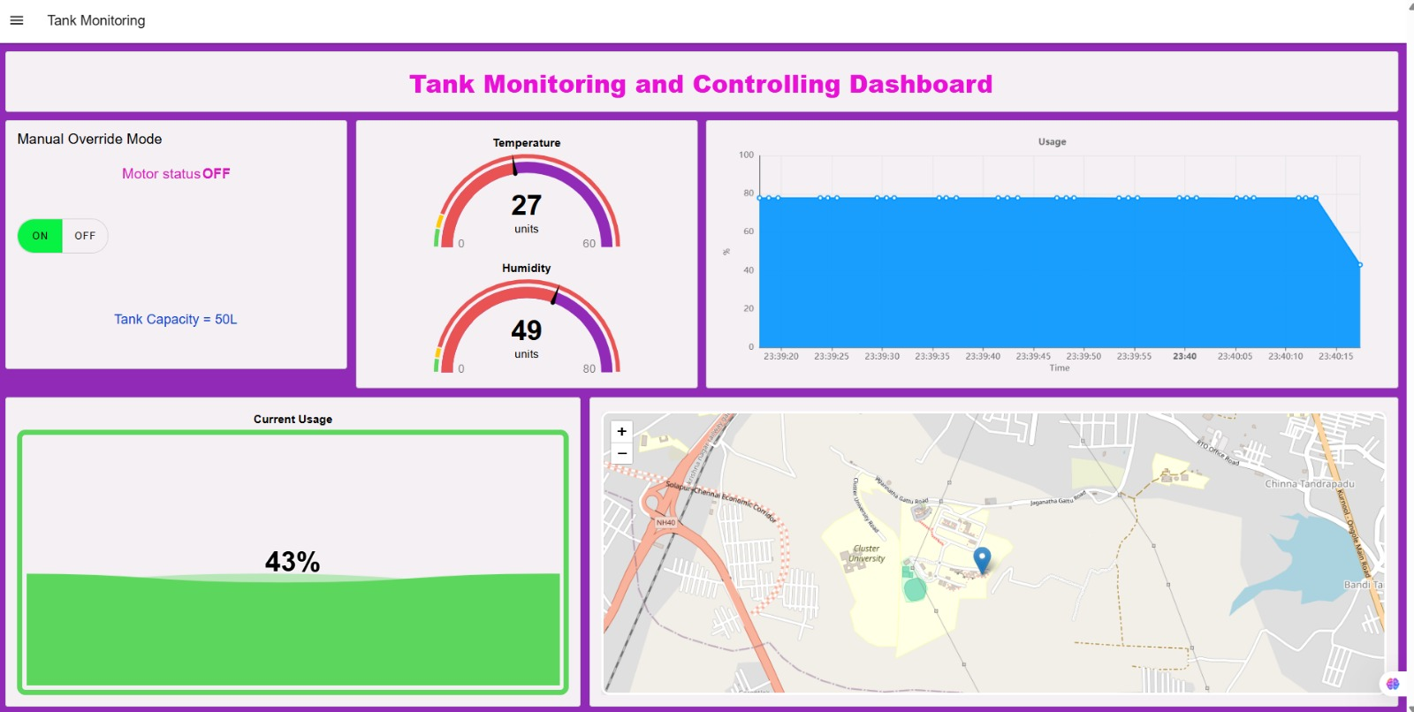
Node-RED Dashboard
Dashboard Features
Live water level percentage
Real-time temperature & humidity
Motor status (LED ON/OFF)
Manual override control
Key Advantages
User-friendly interface
Accessible from any internet-enabled device
Alert Logic
Low Level Alert (<10%)
User can turn ON motor (LED ON)
High Level Alert (>75%)
Motor turned OFF (LED OFF) to prevent overflow

Slide 9
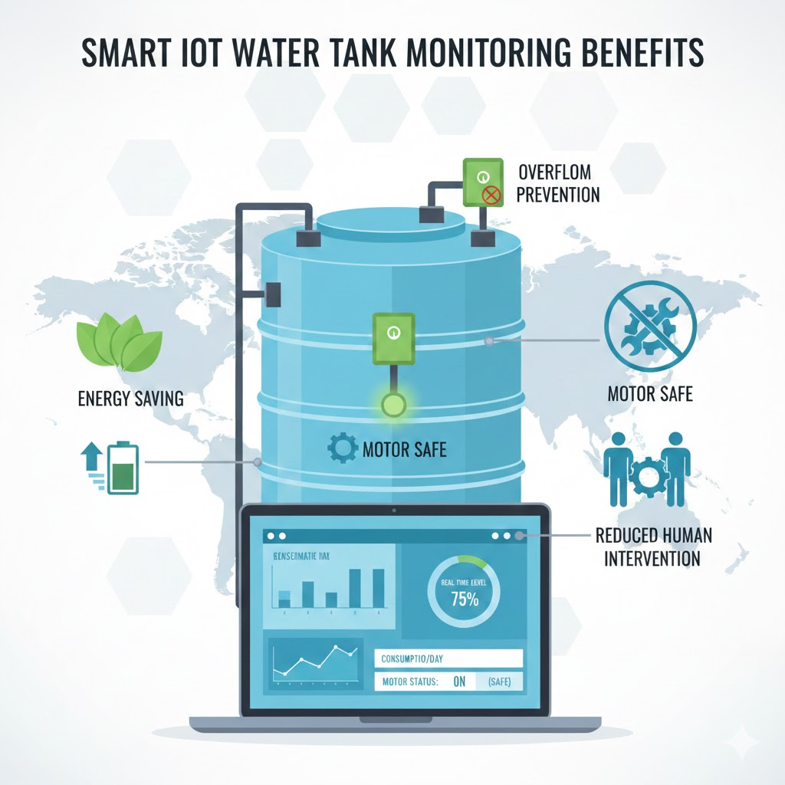
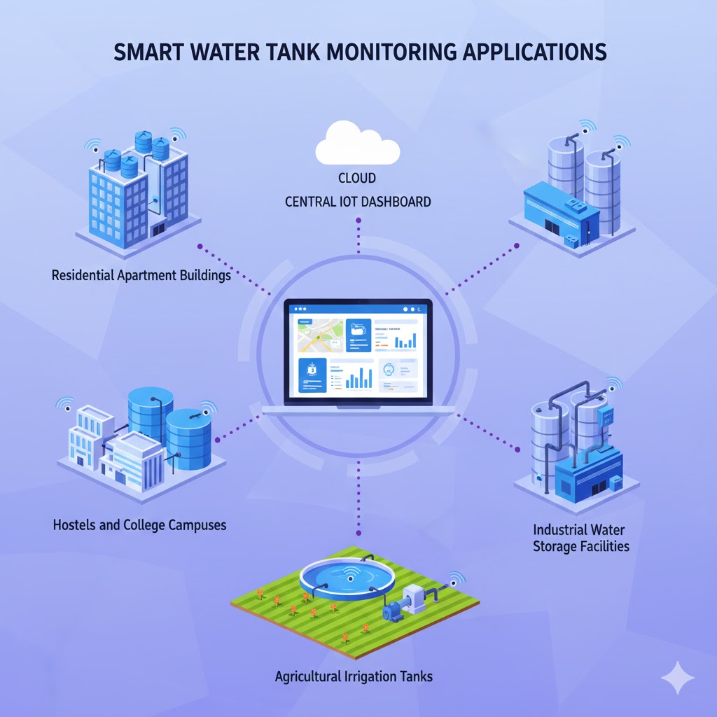
Benefits & Applications
Key Benefits
Prevents water overflow
Avoids motor dry run
Saves electricity
Reduces human supervision
Real-time monitoring & control
Applications
Residential apartments
Hostels & colleges
Agricultural water tanks
Industrial water storage systems

Slide 10
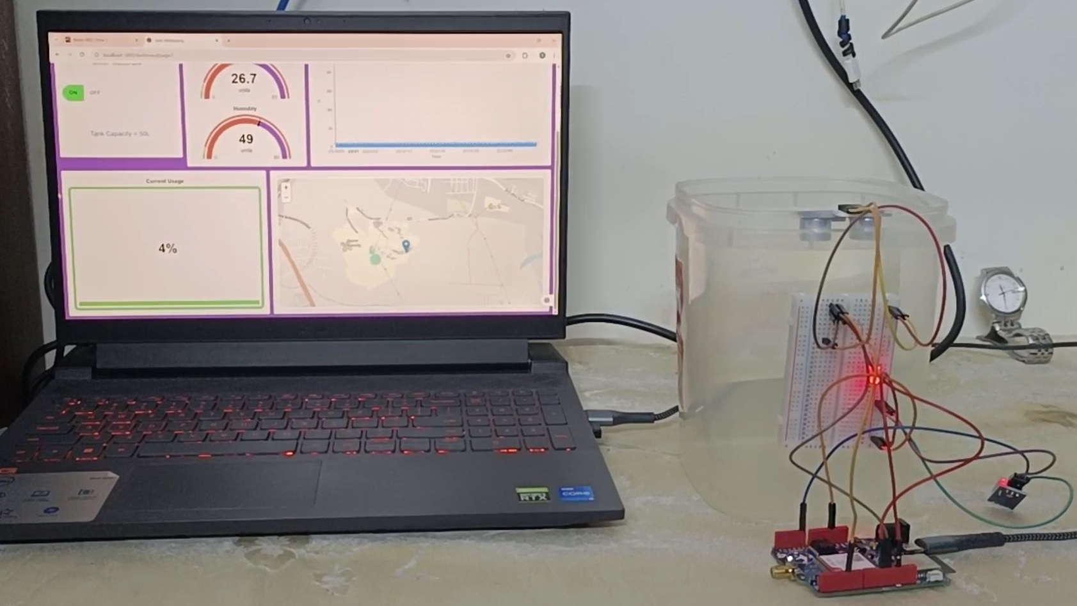
Conclusion
This project successfully demonstrates a low-cost, efficient, and scalable IoT-based solution for real-time water tank monitoring and operational control. By integrating sensors, ESP32, MQTT communication, and a Node-RED dashboard, the system ensures accurate monitoring, timely alerts, and effective control of water resources.
The use of LED-based motor simulation clearly validates the control logic while keeping the prototype simple and safe. Overall, the system addresses major challenges such as water wastage, motor damage, and excessive manual supervision, making it suitable for both small-scale and large-scale water management applications.

